Slide 1
Cloud Computing (MIS 6363.003) Project Presentation
Group 5:
Aditya Emmanuel (AXE200024)
Shweta Sudam Kallapur (SXK210175)
Rohit Krishna Karumanchi (RXK200042)
Akhil Veluru (VXA210023)
Srishti Vinaik (SXV210063)

Slide 2
Industry: E-commerce
Business Objective: To build an e-commerce website that sells used cars using AWS Cloud Services.
Functional Business Requirements:
A website with an option to add desired cars to cart or to save for later purchase.
Login authentication for both buyers and sellers.
Database that stores vehicle, buyer and seller information.
Dashboard that displays metrics related to the vehicles sold.
Payment platform that is enabled with refund option.
Display whether the seller is trusted, contact details etc., in a coherent manner.
Discount deals on cars displayed clearly to the customer.
Separate sections in the website dedicated to customer reviews, delivery options, car accessories etc.
AI chatbot as well as customer representative for efficient customer service.

Slide 3
Non-Functional Business Requirements
24/7 availability across the entire United States.
Transactional database for seller related data.
Secure payment pathway considering the expensive nature of the payments.
Verification of authentic sellers.
Archiving of data older than 5 years.
Real time updation of cars newly added and the cars sold.
Data encryption for the customer and seller data.
Serverless computing engine for processing.
Using a VPC for establishing secure connections between services.

Slide 4
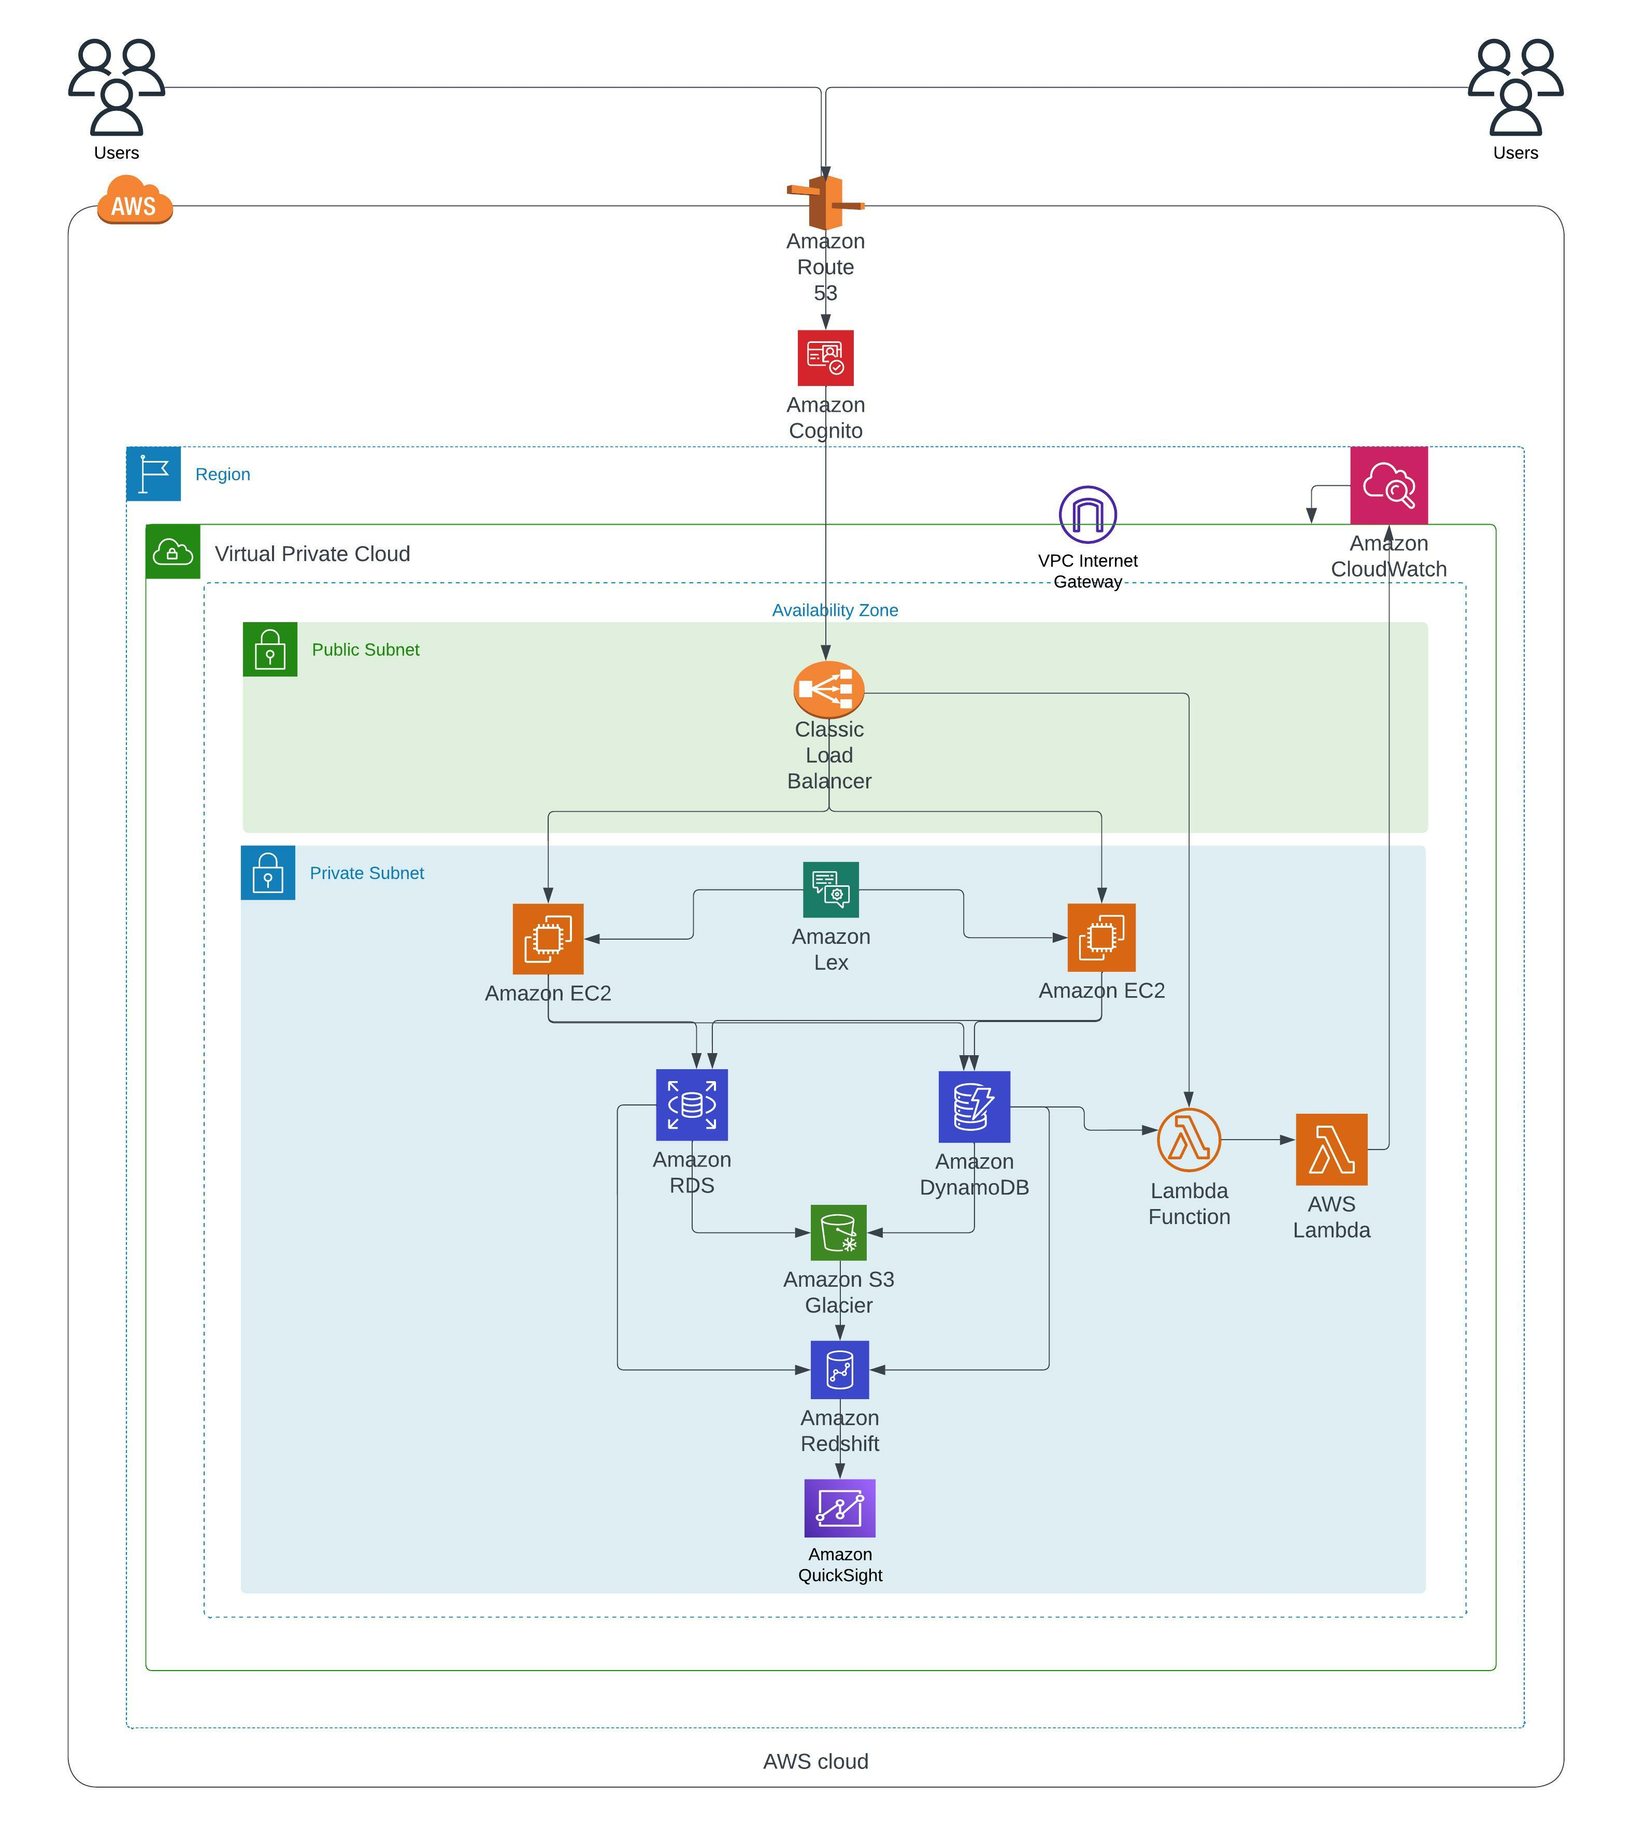
AWS Architecture:

Slide 5
Components of AWS Architecture
Amazon Route 53 (to connect user requests to the application) is used in conjunction with Amazon Cognito for the purpose of login authentication.
Classic load balancer distributes the incoming application traffic across multiple EC2 instances in multiple Availability Zones.
Amazon EC2 provides scalable cloud storage space for storage of vehicle, buyer and seller data.
Amazon RDS is used to store structured data, using MySQL server.
Amazon DynamoDB is used to store unstructured data, using NoSQL.
AWS Lambda is used for various features such as displaying trusted sellers, discount deals etc.

Slide 6
Components of AWS Architecture
Amazon S3 Glacier is used to archive the data that is older than 5 years.
Amazon RedShift is a Data warehouse used to enable complex queries and sophisticated analytics using a SQL-based interface. Redshift is optimized for high-performance analysis and reporting of large datasets by using a columnar storage architecture and parallelizing queries across multiple nodes
Amazon QuickSight is used to display key metrics related to the car sales.
AWS Lex is used for implementation of the AI chatbot.

Slide 7
Alternatives for the chosen components
DNS and User Requests - Amazon Route 53
Alternative: AWS Global Accelerator for routing user traffic over the AWS global network.
Authentication-Amazon Cognito
Alternative: AWS Identity and Access Management (IAM), Auth0, or Okta for more customized identity solutions.
Load Balancing-Classic Load Balancer
Alternative: AWS Application Load Balancer for HTTP/HTTPS traffic or Network Load Balancer for TCP/UDP traffic.
DNS and User Requests - Amazon Route 53
Alternative: AWS Global Accelerator for routing user traffic over the AWS global network.
Authentication - Amazon Cognito
Alternative: AWS Identity and Access Management (IAM), Auth0, or Okta for more customized identity solutions.
Load Balancing - Classic Load Balancer
Alternative: AWS Application Load Balancer for HTTP/HTTPS traffic or Network Load Balancer for TCP/UDP traffic.
Compute - Amazon EC2
Alternative: AWS Fargate for serverless compute or AWS Elastic Beanstalk for a PaaS solution.
Structured Data Storage - Amazon RDS with MySQL
Alternative: AWS Aurora for a MySQL and PostgreSQL-compatible relational database with better performance or Amazon Neptune for graph-based storage.

Slide 8
Alternatives for the chosen components
Unstructured Data Storage-Amazon DynamoDB
Alternative: AWS Document DB for MongoDB compatibility or Amazon S3 for simple object storage.
Serverless Computing-AWS Lambda
Alternative: AWS Step Functions for orchestrating serverless workflows.
Archival Storage - Amazon S3 Glacier
Alternative: AWS Storage Gateway for a hybrid storage solution involving on-premises and cloud storage.
Data Warehousing - Amazon RedShift
Alternative: AWS Athena for serverless SQL queries directly on Amazon S3 or Snowflake (non-AWS).
Business Intelligence - Amazon QuickSight
Alternative: AWS Data Pipeline for more complex ETL or Tableau for advanced visualizations (non-AWS).
Chatbot - AWS Lex
Alternative: Amazon Polly and AWS Transcribe for a more customized, build-it-yourself voice/chatbot experience.

